Slide 1
Kupongo: scrumdiddlyumptious
Kupongo Team

Slide 2
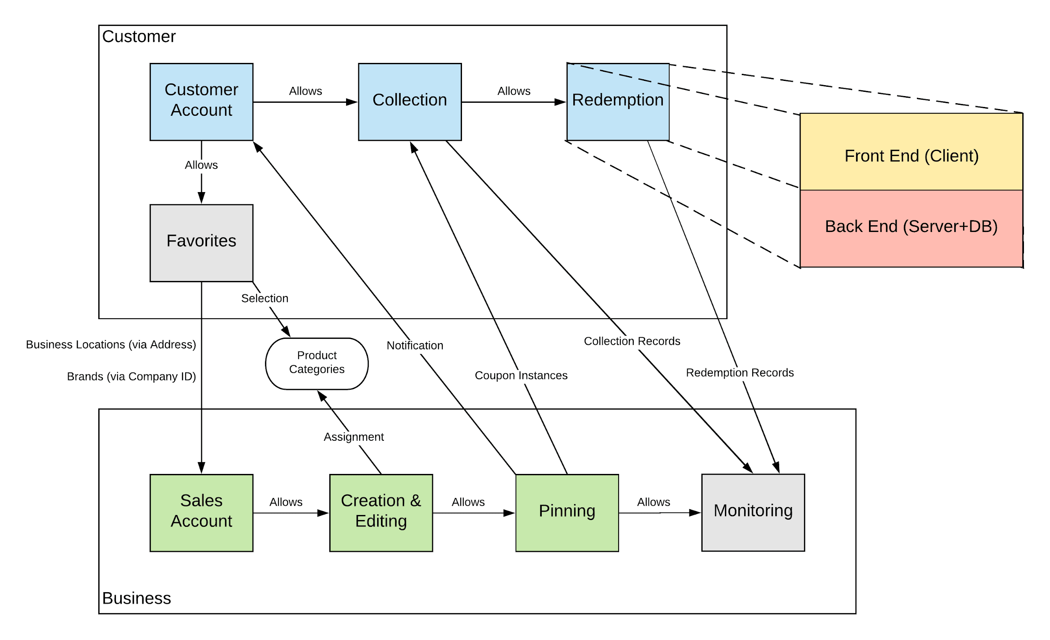
Subsystem Overview
Notes:
Nathan

Slide 3
Sales Account
Front End Dev: Melvin Back End Dev: Preston
Requirements/ Backlog (stories associated with this subsystem in order of priority):
A business can register for a business account
The sales executive can:
create a sales account as a member of a registered business.
login to their sales account using their business email and password.
Notes:
Melvin

Slide 4
Coupon Creation & Editing
Front End Dev: Nathan Back End Dev: Kevin
Requirements/ Backlog (stories associated with this subsystem in order of priority):
The sales executive can:
enter valid coupon information and select coupon options to create a new coupon template
view the coupon templates they have created
edit or remove the coupon instances they have pinned
edit a coupon template they have created
Notes:
Nathan + Kevin

Slide 5
Coupon Pinning
Front End Dev: David Back End Dev: Kevin
Requirements/ Backlog (stories associated with this subsystem in order of priority):
The sales executive can:
confirm and save the coupon pin locations
view the coupon instances they have pinned
enter coupon instance information for each GPS pin location
select an existing template to pin to one or more locations
select multiple GPS locations to pin an instance of a coupon
Notes:
David + Kevin
For this slide, I’ll introduce our roles and then Kevin, you can explain the requirements if you feel comfortable with that, otherwise I can do that too.

Slide 6
Customer Account
Front End Dev: Preston Back End Dev: Melvin
Requirements/ Backlog (stories associated with this subsystem in order of priority):
The customer can:
create account or log into an existing account
Add user information to database / check user information is correct
view home page
Retrieve user information from database
Display home page
verify account information (email and password)
Send email to user to confirm credentials
recover/Update password
Send user to page to recover / update their password
Update database with new login credentials
Notes:
Preston + Melvin

Slide 7
Coupon Collection
Front End Dev: David Back End Dev: Nathan
Requirements/ Backlog (stories associated with this subsystem in order of priority):
The customer can:
see nearby coupons on a live map.
Queries to backend giving it a bounding box and expects back a list of CouponViews to pin to map as markers.
walk up to a coupon and collect it.
Involves constantly checking location of user and seeing if the user can redeem the coupon or not.
get live map updates as they move across locations.
Want to remove any coupons redeemed by someone else or have been expired.
Notes:
David + Nathan
Taking back-end for now, if anyone wants to help with back-end let me know and you can be assigned back end.

Slide 8
Coupon Redemption
Front End Dev: Nathan Back End Dev: Kevin
Requirements/ Backlog (stories associated with this subsystem in order of priority):
The customer can:
view all collected coupons
select a coupon and display coupon details for redemption at a retail location
3. The database will remove coupon upon redemption
Notes:
Nathan + Kevin

Slide 9
Favorites/Notifications (ATA)
Front End Dev: David Back End Dev: Kevin
Requirements/ Backlog (stories associated with this subsystem in order of priority):
The customer must be able to:
add a company from an existing coupon to a favorites list
search for companies by name and add them to a favorites list
view and modify the list of all their favorite companies
receive notifications when a company on their favorites list posts a coupon near them.
select the distance within which they will be notified if a company posts a coupon
Notes:
Nathan + Kevin

Slide 10
Monitoring (ATA)
Front End Dev: Preston Back End Dev: Melvin
Requirements/ Backlog (stories associated with this subsystem in order of priority):
The sales executive can:
view collection rate of pinned coupons
Retrieve number of coupons collected by time / location
view redemption rate of pinned coupons
Retrieve number coupons redeemed by time/ location
Notes:
Preston + Melvin

Slide 11
